Slide 1
INTRODUCTON
Ms Deepika
Assistant Professor

Slide 2
INTRODUCTION
If you need to search your roll number in 20000 pages of PDF document (roll numbers are arranged in increasing order) how would you do that?

Slide 3
INTRODUCTION
If you will try to search it randomly or in a sequential manner it will take too much time. You might get frustrated after some time.
You can try another solution which is given below…
Go to page no. 10000
If your roll no. is not there, but all other roll no. in that page are lesser than your than
Go to page no. 15000
Still if your roll no. is not there. but this time all other roll no. is greater than your.
Go to page no. 12500

Slide 4
INTRODUCTION
Continue the same process and within 30-40 seconds you will find your roll number.
Congratulations… you just have used the Binary Search algorithm unintentionally.
This is just a simple example and you might have understood a little bit that why you need to learn data structure and algorithms and its importance in real life.

Slide 5
Reason to learn DS and ALGO
If you want to crack the interviews and get into the product based companies
If you love to solve real-world complex problems.

Slide 6
IMPORTANCE OF DS IN REAL LIFE
Have you ever been scolded by your parents when you were unable to find your book or clothes in your messed-up room? Definitely yes…your parents are right when they give the advice to keep everything in the right place so the next time you can get your stuff easily.
Here you need to arrange and keep everything (data) in such a structure that whenever you need to search for something you get that easily and as soon as possible. This example gives a clear idea that how important it is to arrange or structure the data in real life.

Slide 7
IMPORTANCE OF DS IN REAL LIFE
Now take the example of a library. If you need to find a book on Set Theory from a library, you will go to the maths section first, then the Set Theory section. If these books are not organized in this manner and just distributed randomly then it will be frustrating to find a specific book.
So data structures refer to the way we organize information on our computers. Computer scientists process and look for the best way we can organize the data we have, so it can be better processed based on the input provided

Slide 8
DS APPLICATIONS IN REAL LIFE
A lot of newbie programmers have this question that where we use all the stuff of data structure and algorithms in our daily life and how it’s useful in solving the real-world complex problem

Slide 9
DS APPLICATIONS IN REAL LIFE
A lot of newbie programmers have this question that where we use all the stuff of data structure and algorithms in our daily life and how it’s useful in solving the real-world complex problem
interested in getting into the top tech giant companies or not ?
They still use DSA concepts

Slide 10
FACEBOOK
Can you just imagine that your friends on Facebook, friends of friends, mutual friends they all can be represented easily by Graph?
Relax….sit for a couple of moments and think again…you can apply a graph to represent friends’ connections on Facebook.

Slide 11
DECK OF CARDS
If you need to keep a deck of cards and arrange it properly how would you do that?
You will throw it randomly or you will arrange the cards one over another and from a proper deck.
You can use Stack here to make a proper arrangement of cards one over another.

Slide 12
DICTIONARY
If you need to search for a word in the dictionary, what would be your approach?
Do you go page by page or do you open some page and if the word is not found you open a page prior to/later to one opened depending upon the order of words to the current page (Binary Search)

Slide 13
IN NUTSHELL WHY WE NEED DS
Arranging data in a specific structure is really helpful in saving a lot of time and it becomes easier to manipulate or use them.
The same goes for the algorithm…we all want to save our time, energy and resources.
We all want to choose the best approach to solve the problems in our daily life.

Slide 14
WHAT IS DS
A data structure is a storage that is used to store and organize data.
It is a way of arranging data on a computer so that it can be accessed and updated efficiently.
A data structure is not only used for organizing the data. It is also used for processing, retrieving, and storing data.

Slide 15
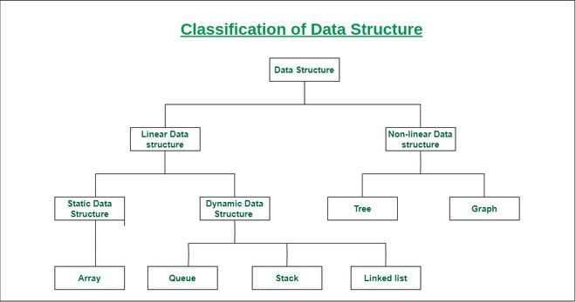
CLASSIFICATION

